Slide 1

MNIST Handwritten Digit
Classification
Using a Neural Network
Python • TensorFlow/Keras • OpenCV

Slide 2
Project Objective
• Classify handwritten digit images into one of 10 classes: 0–9.
• Learn digit patterns from the MNIST training set.
• Evaluate the trained model on unseen test images.
• Provide a simple predictive system for a new image.

Slide 3
Dataset & Preprocessing
• 60,000 training images and 10,000 test images.
• Each image is 28 × 28 pixels and grayscale.
• Labels represent digits 0 through 9.
• Pixel values are normalized by dividing by 255.
• External images are converted to grayscale, resized to 28 × 28, normalized, and reshaped.

Slide 4
Neural Network Architecture
28×28
Input
Flatten
784
Dense
50 ReLU
Dense
50 ReLU
Dense
10 Sigmoid
Optimizer: Adam | Loss: sparse categorical crossentropy | Metric: accuracy

Slide 5
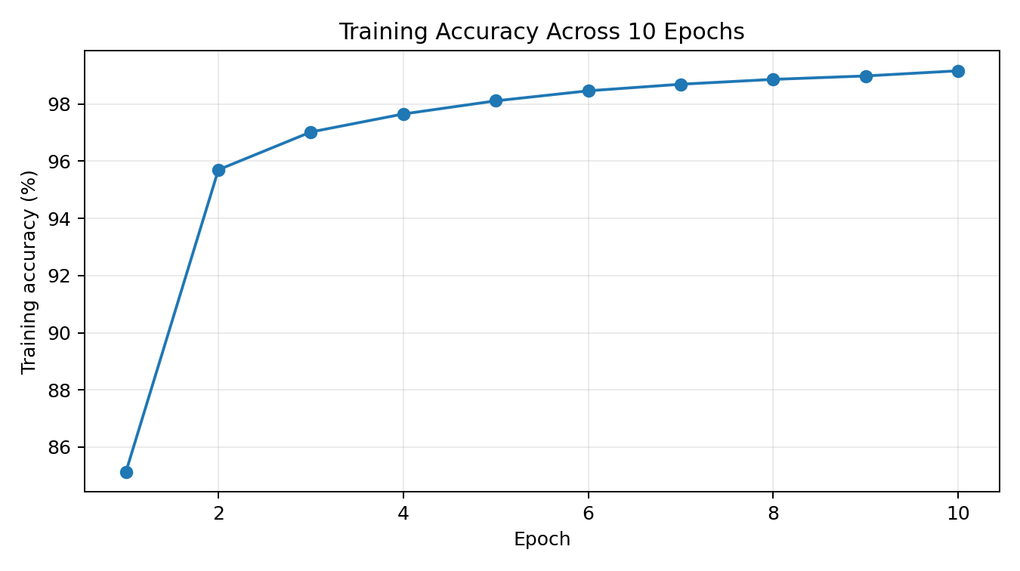
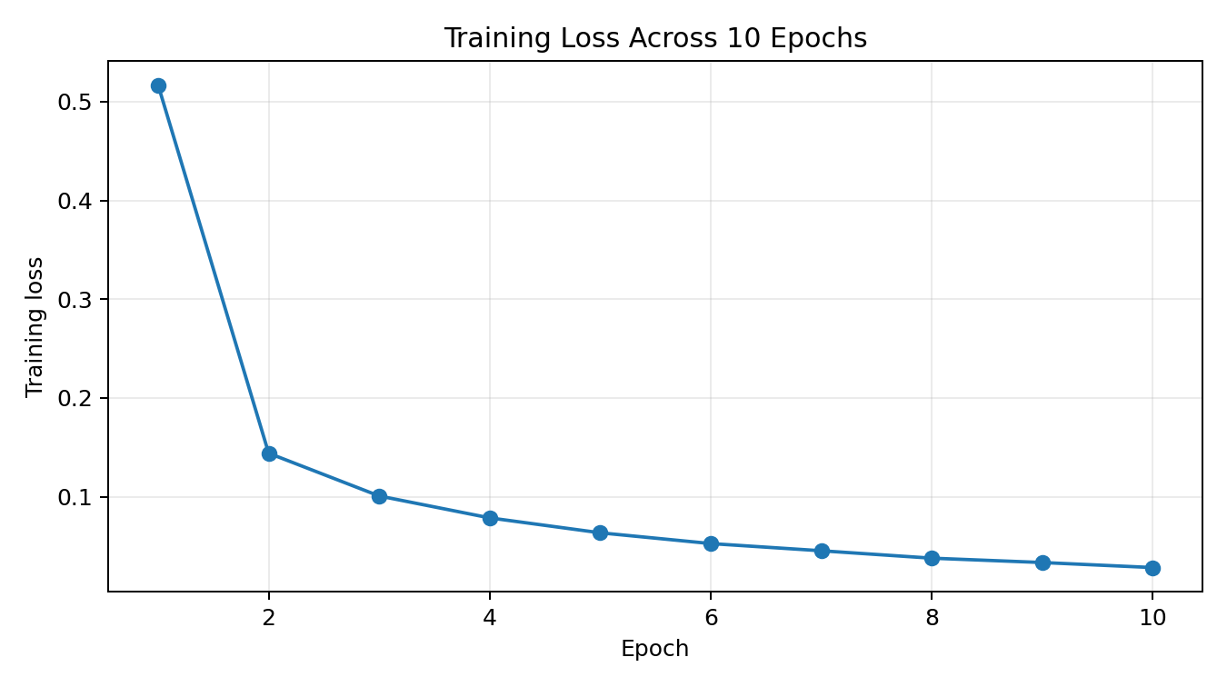
Training Performance
Training accuracy: 85.14% → 99.16% across 10 epochs

Slide 6
Model Evaluation
• Final training accuracy: 99.16%.
• Test accuracy: 97.04% (notebook text reports 97.1%).
• Predictions are produced as scores for the 10 classes.
• np.argmax converts the highest-scoring class into the predicted digit.
99.16%
Training
97.04%
Test
10
Classes
28×28
Input

Slide 7
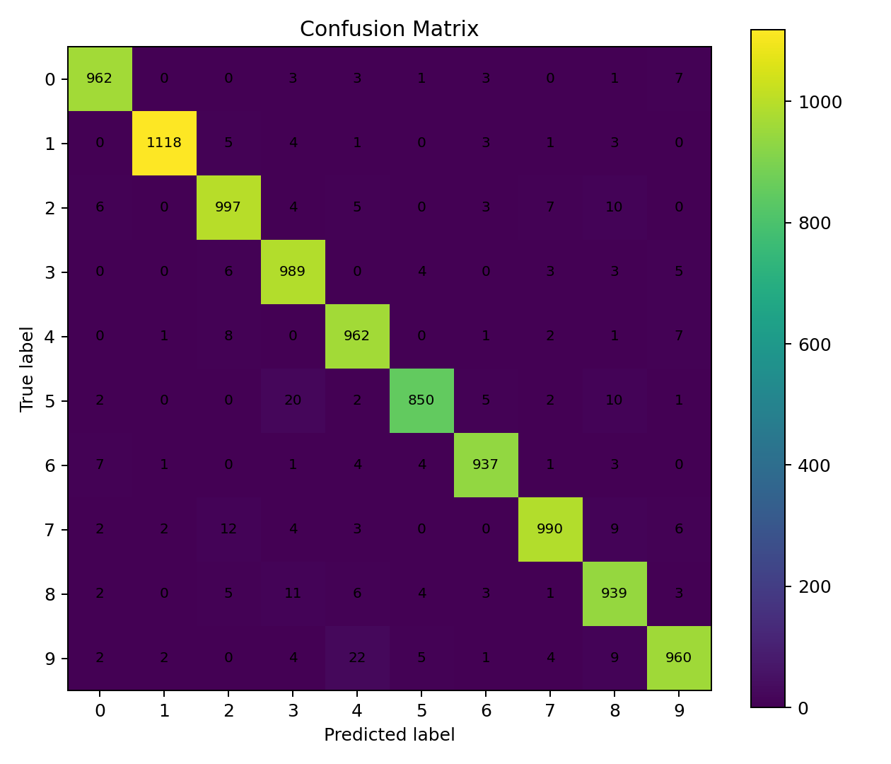
Confusion Matrix
• Diagonal values represent correctly classified samples.
• Most predictions lie on the diagonal.
• The matrix helps identify which digit classes are most often confused.

Slide 8
Predictive System
• Read image from a user-provided path.
• Convert to grayscale.
• Resize to 28 × 28.
• Normalize and reshape to (1, 28, 28).
• Run model.predict() and select the class with np.argmax().
• Supplied sample prediction: 3.

Slide 9
Technology Stack
• Python — core programming language
• TensorFlow / Keras — neural network, training, evaluation and inference
• NumPy — numerical operations and reshaping
• OpenCV — image loading, grayscale conversion and resizing
• Matplotlib + Seaborn — visualization and confusion matrix
• Google Colab — notebook execution environment used by the project

Slide 10
Limitations & Future Scope
• Current model is a fully connected network trained on MNIST-style images.
• External images may differ from MNIST in scale, centering, contrast, and background.
• Future: use a CNN for stronger spatial feature extraction.
• Future: add robust image preprocessing and model save/load.
• Future: build a web UI or API for real-time digit prediction.
• Future: add precision, recall, and F1-score reporting.

Slide 11
Conclusion
• The project demonstrates a complete deep-learning classification workflow.
• The neural network reaches approximately 97.04% accuracy on the MNIST test set.
• A confusion matrix provides class-level error analysis.
• The predictive pipeline successfully recognizes the supplied sample as digit 3.
• The project can be extended into a CNN-based or web-deployed application.

